Slide 1

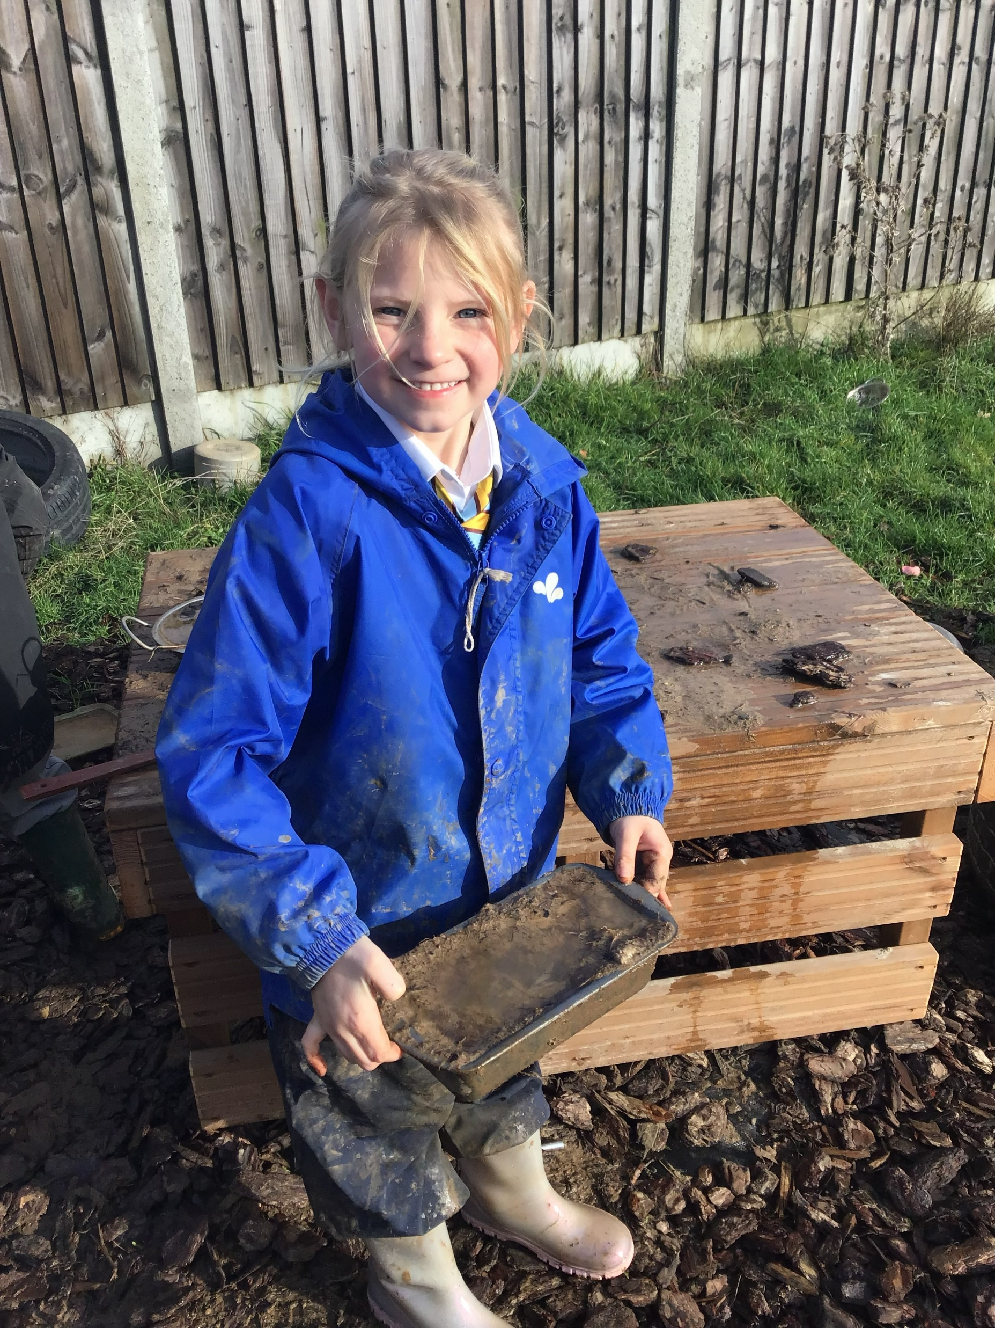
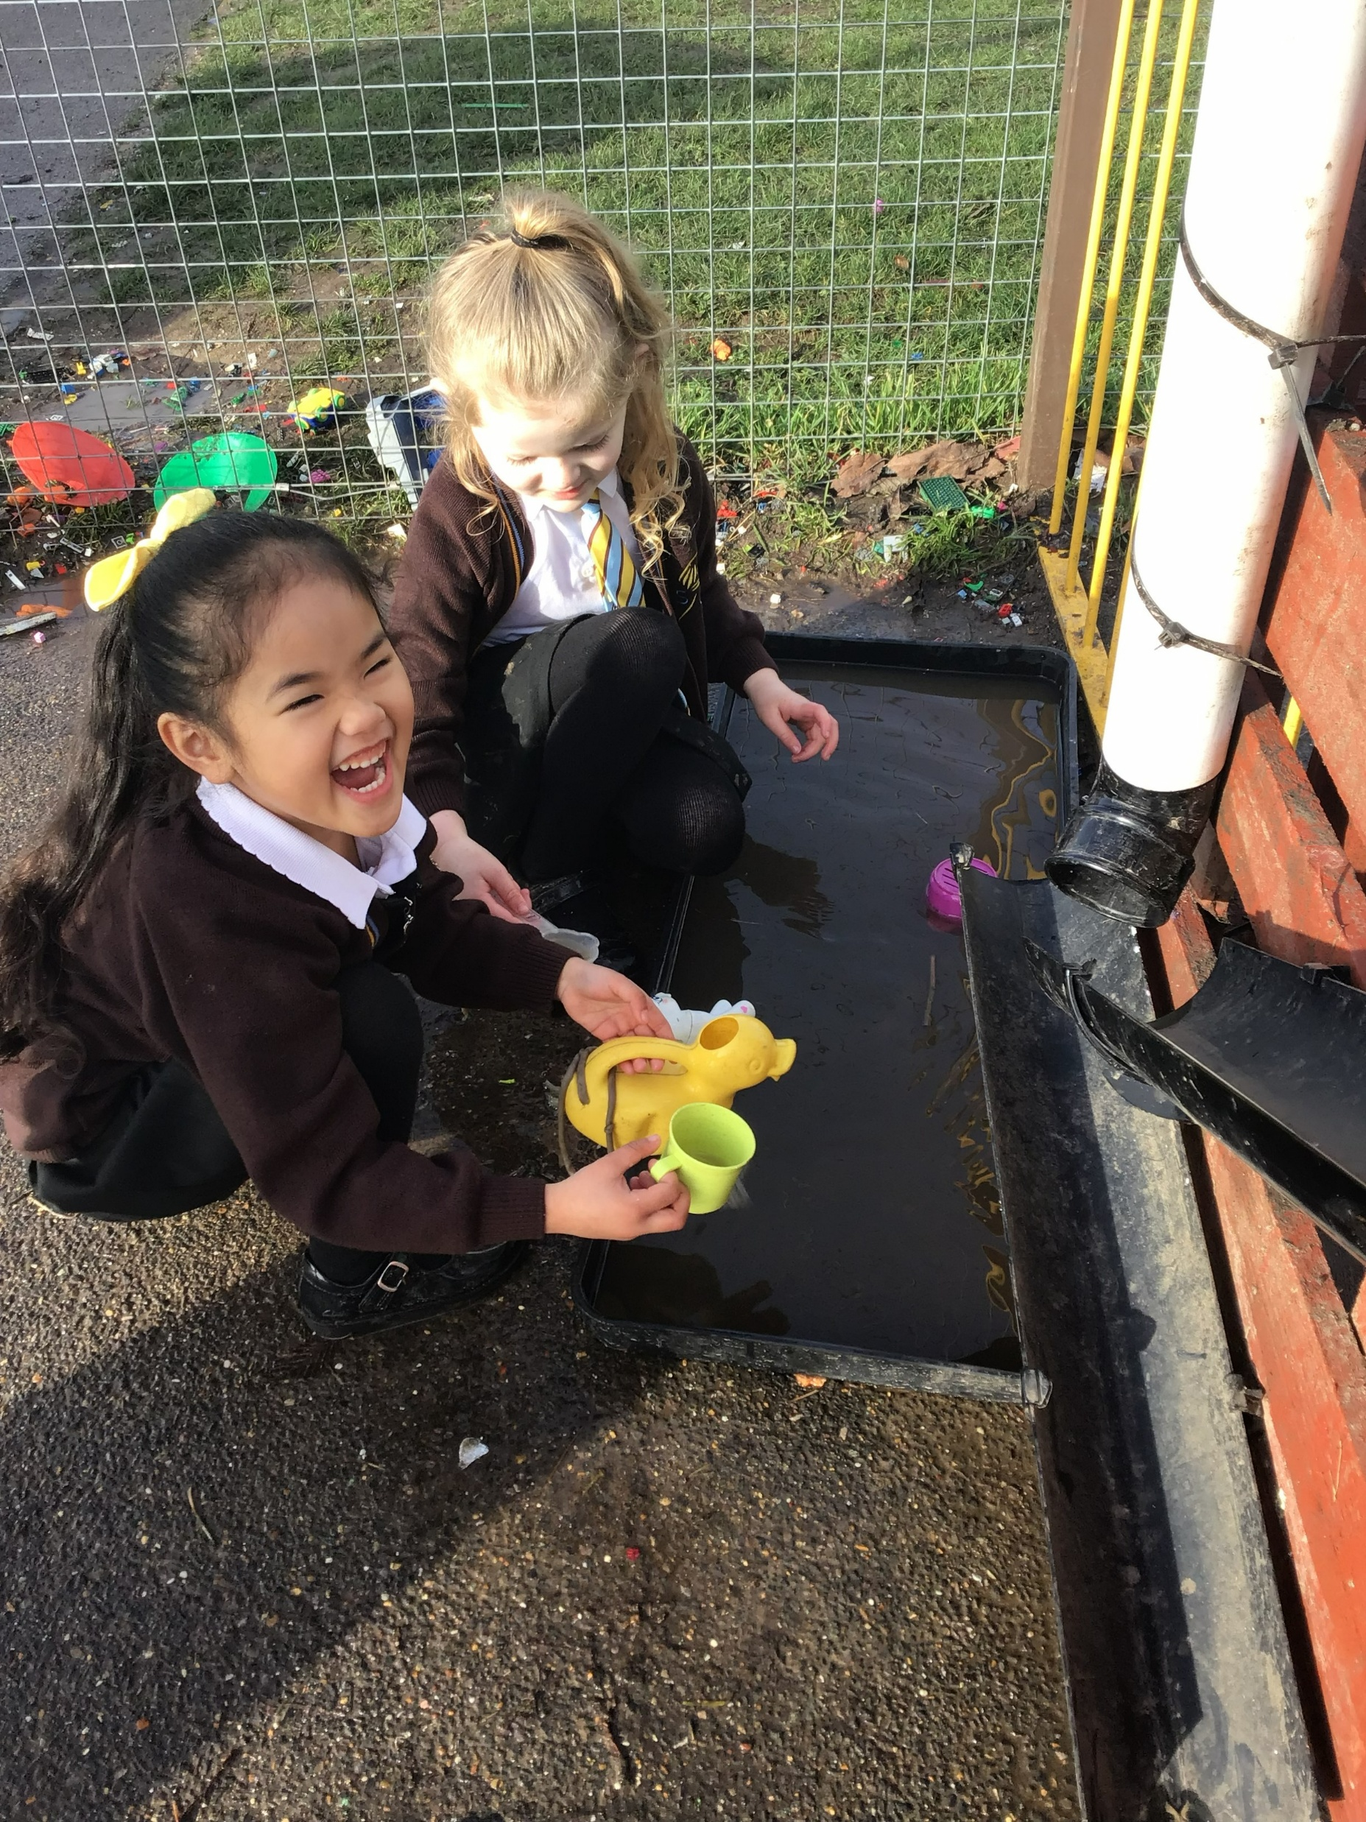
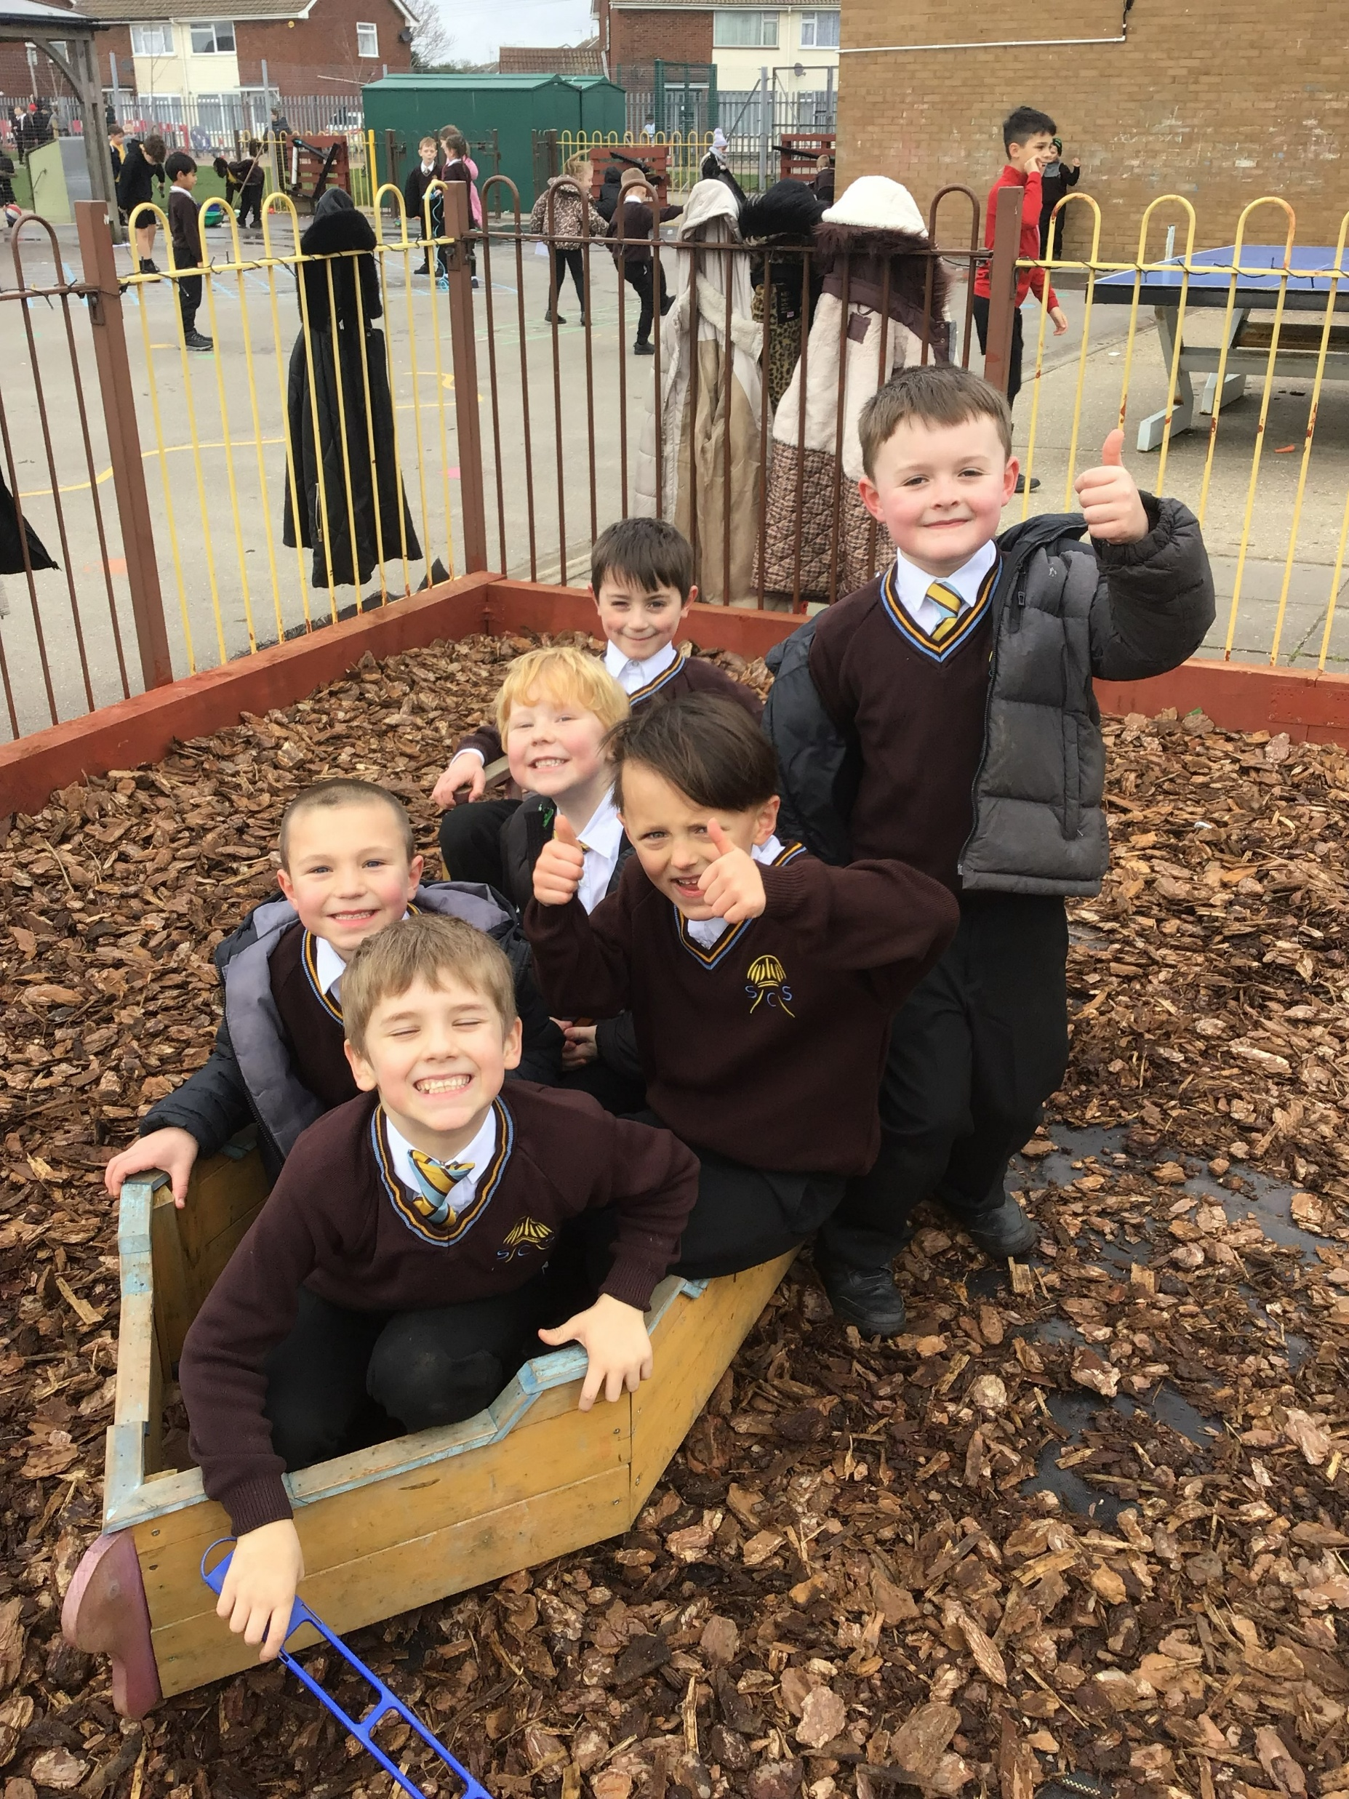
OPAL Stay and Play Parent Sessions!
Come to the hall first to hear about OPAL play, then join your child on the playground for our stay and play session. We can’t wait to show you what we do!
Tuesday 19th May
EYFS and KS1- 11.15-11.50am
KS2- 1.00-1.35pm

